Slide 1
Competitive Programming
25 October 2024

Slide 2
Priority Queue as BST
Priority queues are usually represented by a binary heap.
Binary heap is a balanced tree designed to keep at the top the smaller or the greatest element. As a result, access to the smallest element is O(1).
Why cannot we use just red-black tree?
Insertion or deletion of the top element is the same for both O(log(N)). But insertion in case of binary heap simpler. Red-black tree keep the collection sorted.
Binary heap can be stored in contiguous memory as a result it is more efficient in real-world performance. Do you remember shift operations in red-black tree? In case of contiguous memory leads to O(N) which breaks whole idea behind the tree.

Slide 3
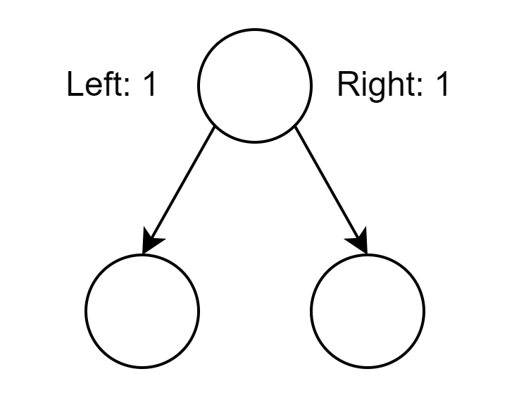
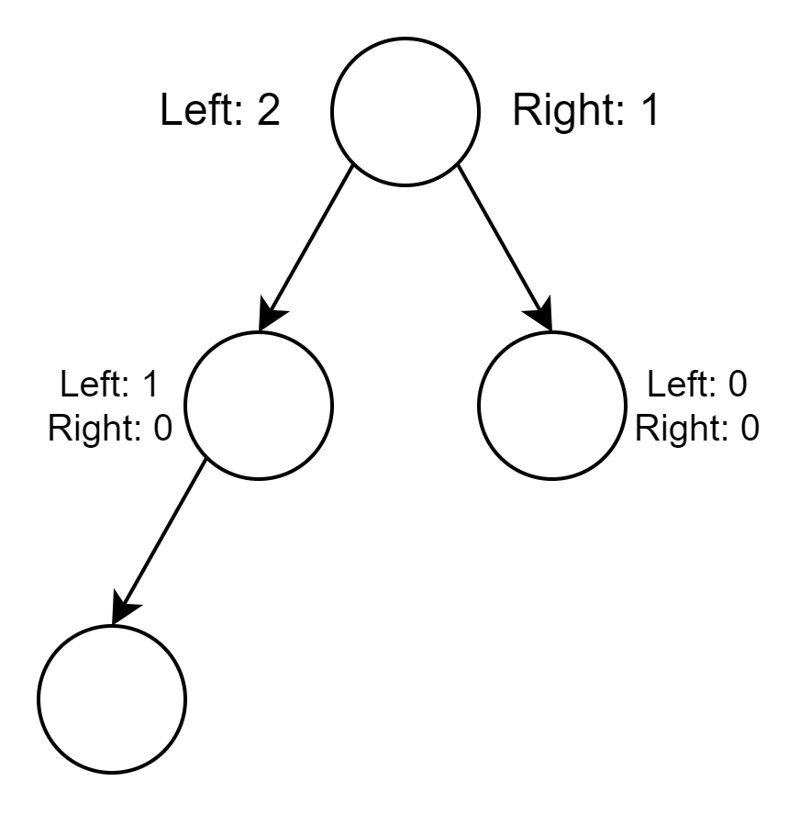
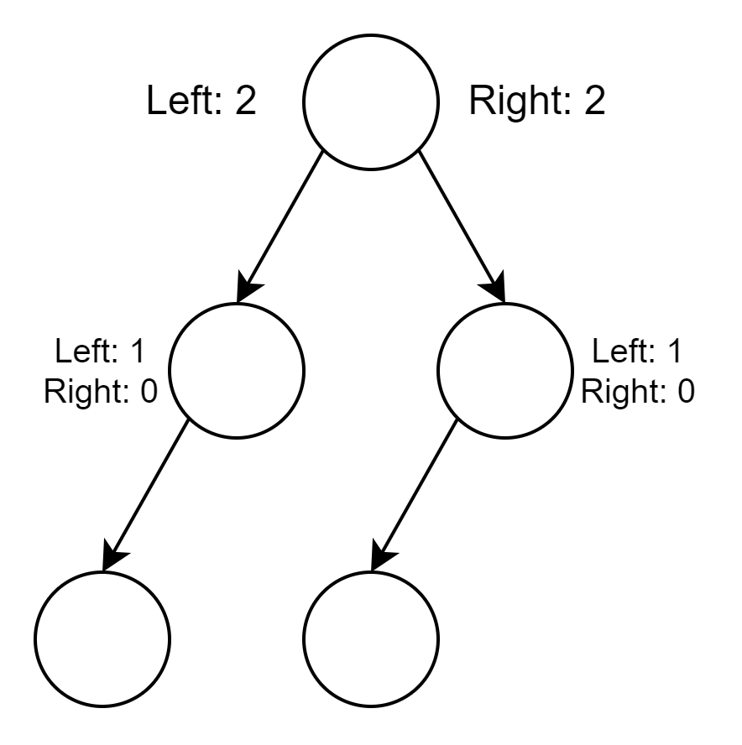
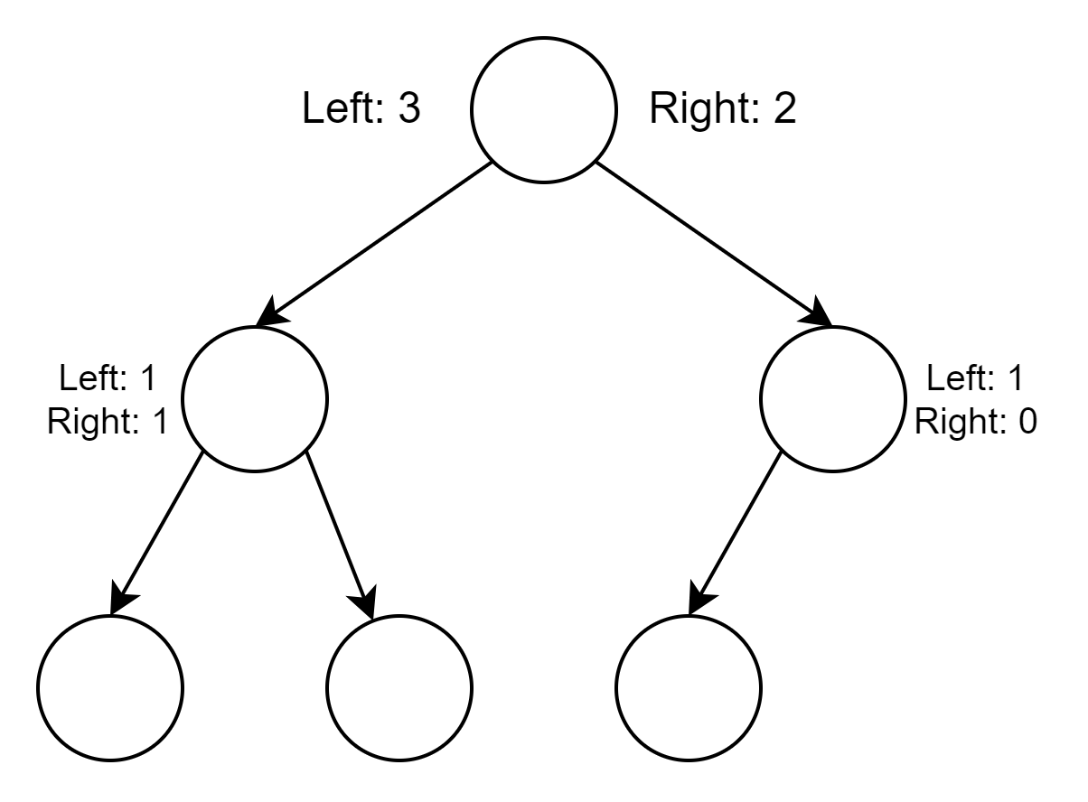
Binary Heap
Easy to balance – add to the shortest branch.

Slide 4
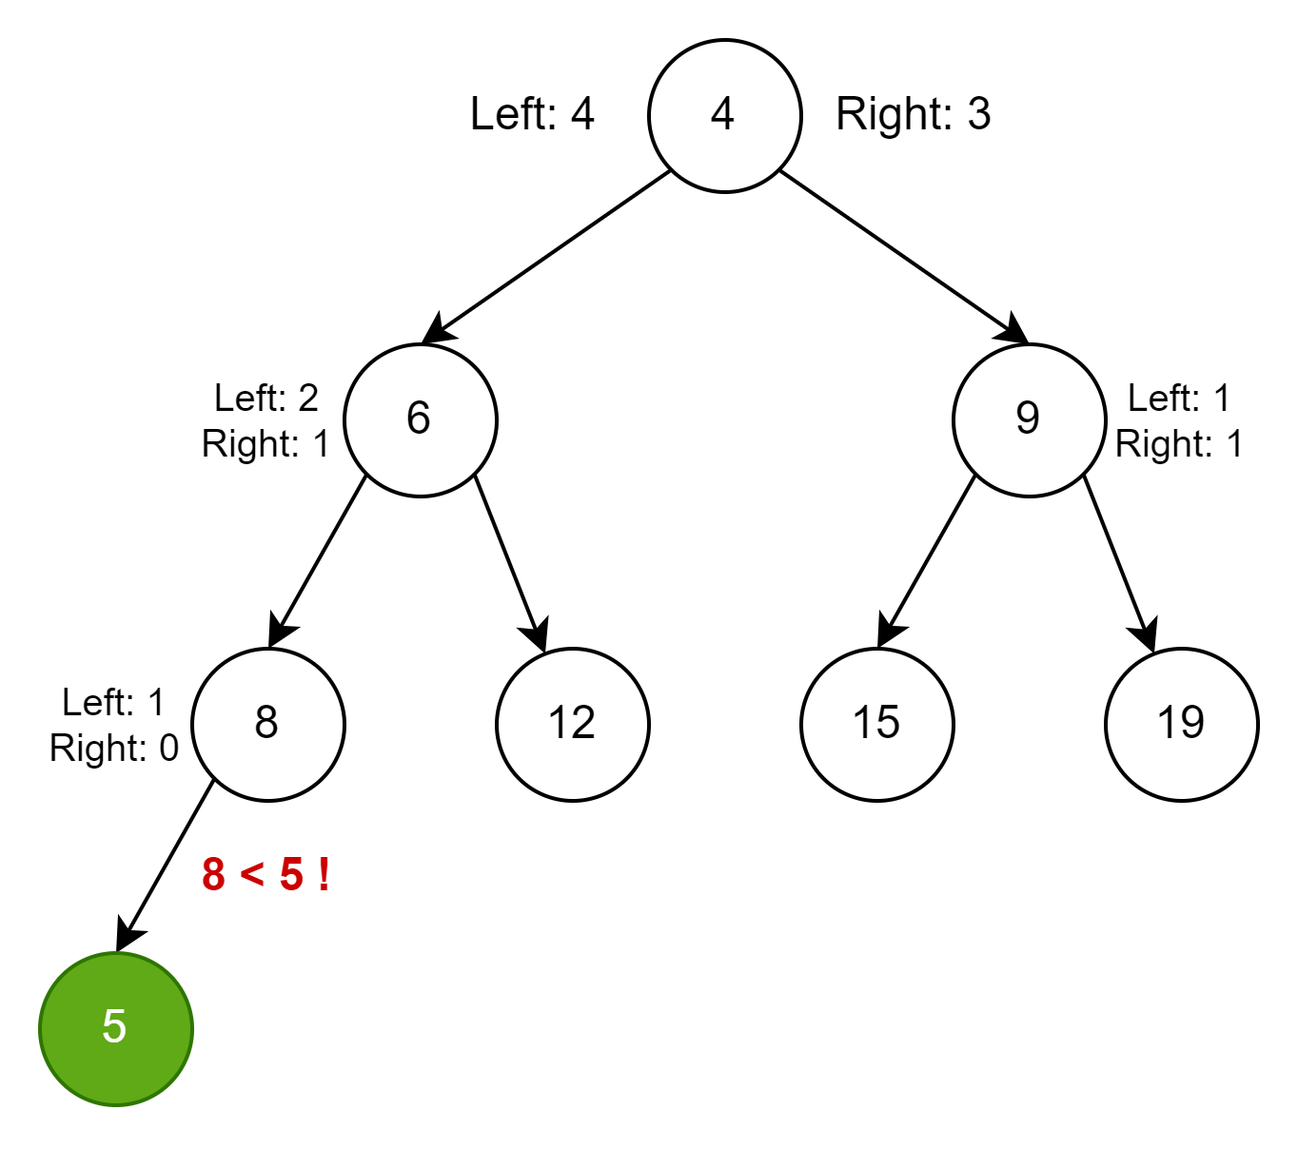
Binary Heap – How to Keep Integrity
Easy to add node and balance – just bubble added node.

Slide 5
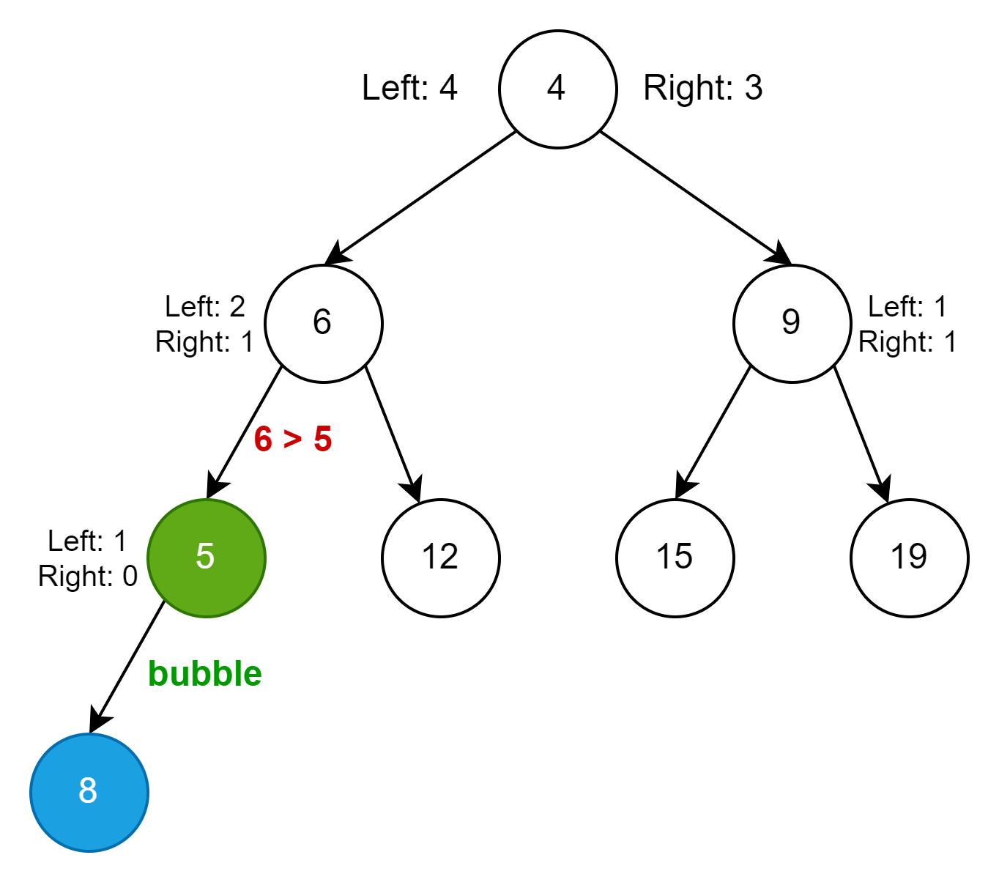
Binary Heap – How to Keep Integrity
Easy to add node and balance – just bubble added node.

Slide 6
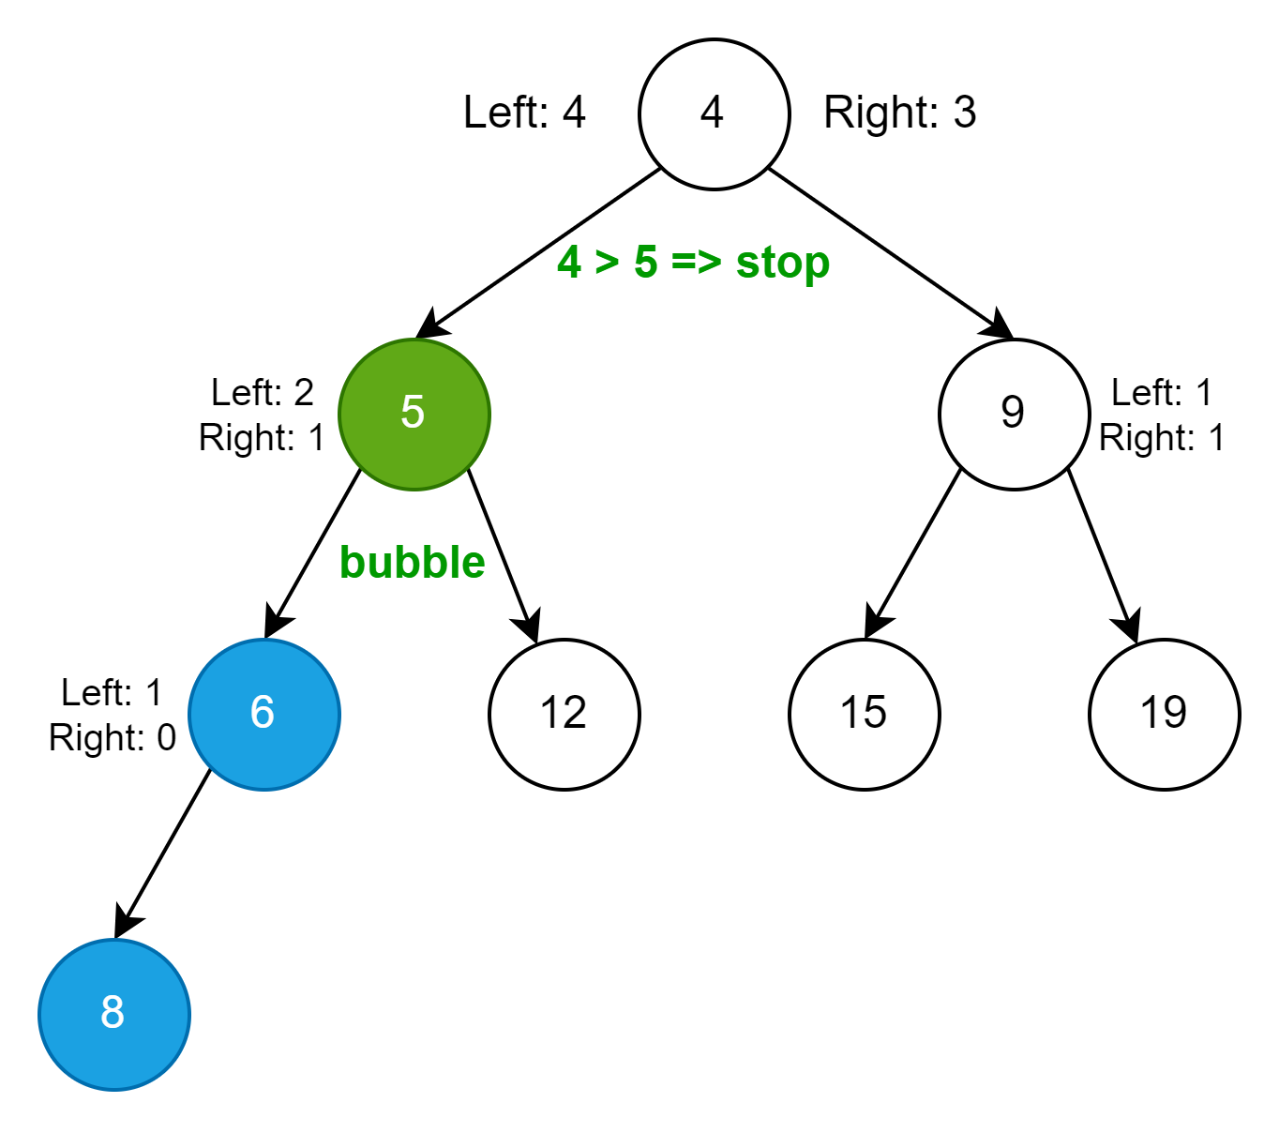
Binary Heap – How to Keep Integrity
Easy to add node and balance – just bubble added node.

Slide 7
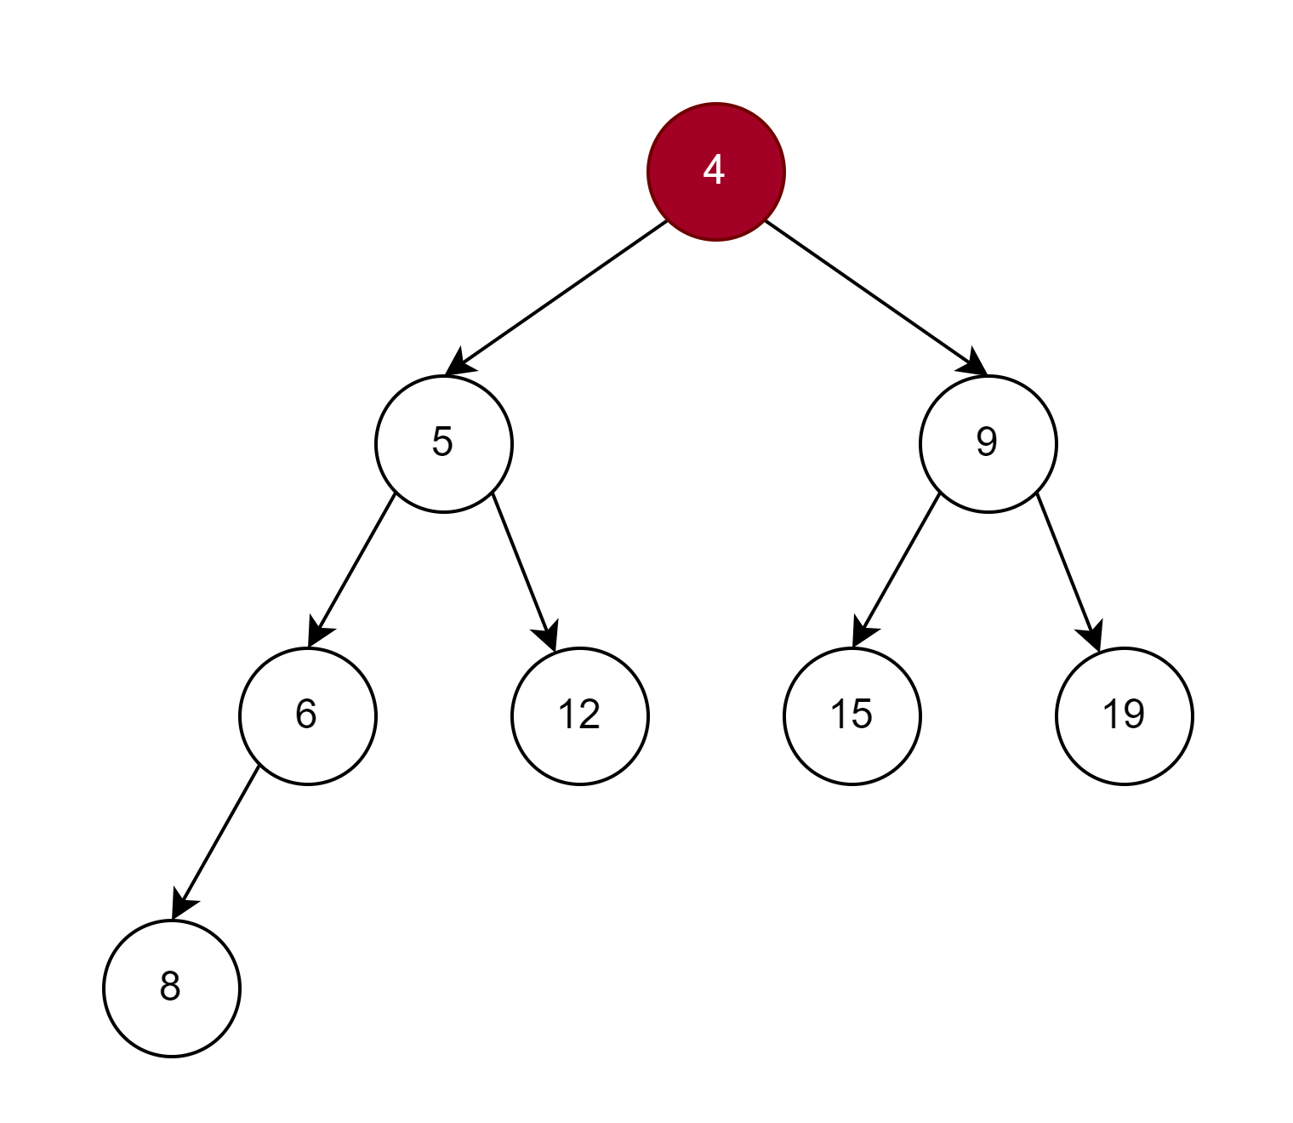
Binary Heap – How to Keep Integrity
Easy to delete and balance – just bubble added node.

Slide 8
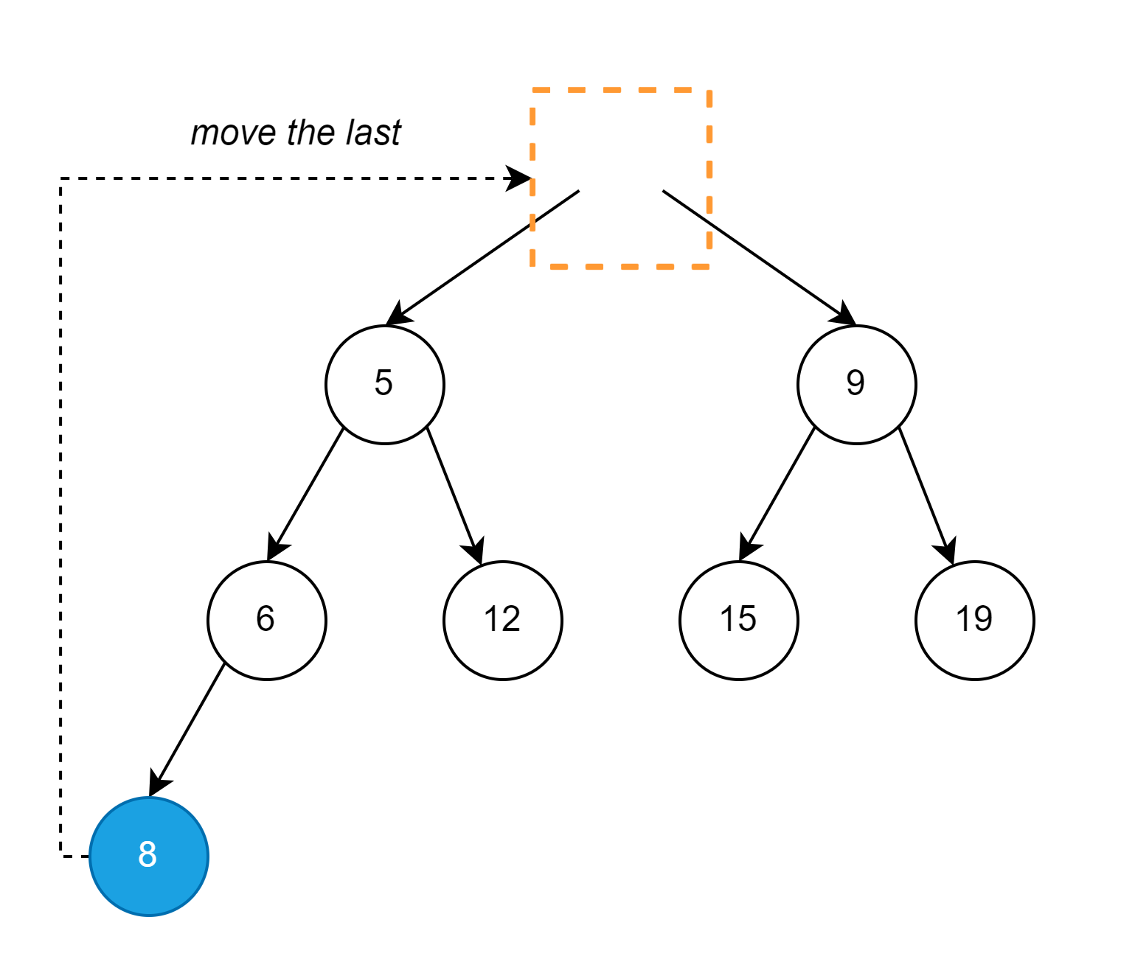
Binary Heap – How to Keep Integrity
Easy to delete and balance – just bubble added node.

Slide 9
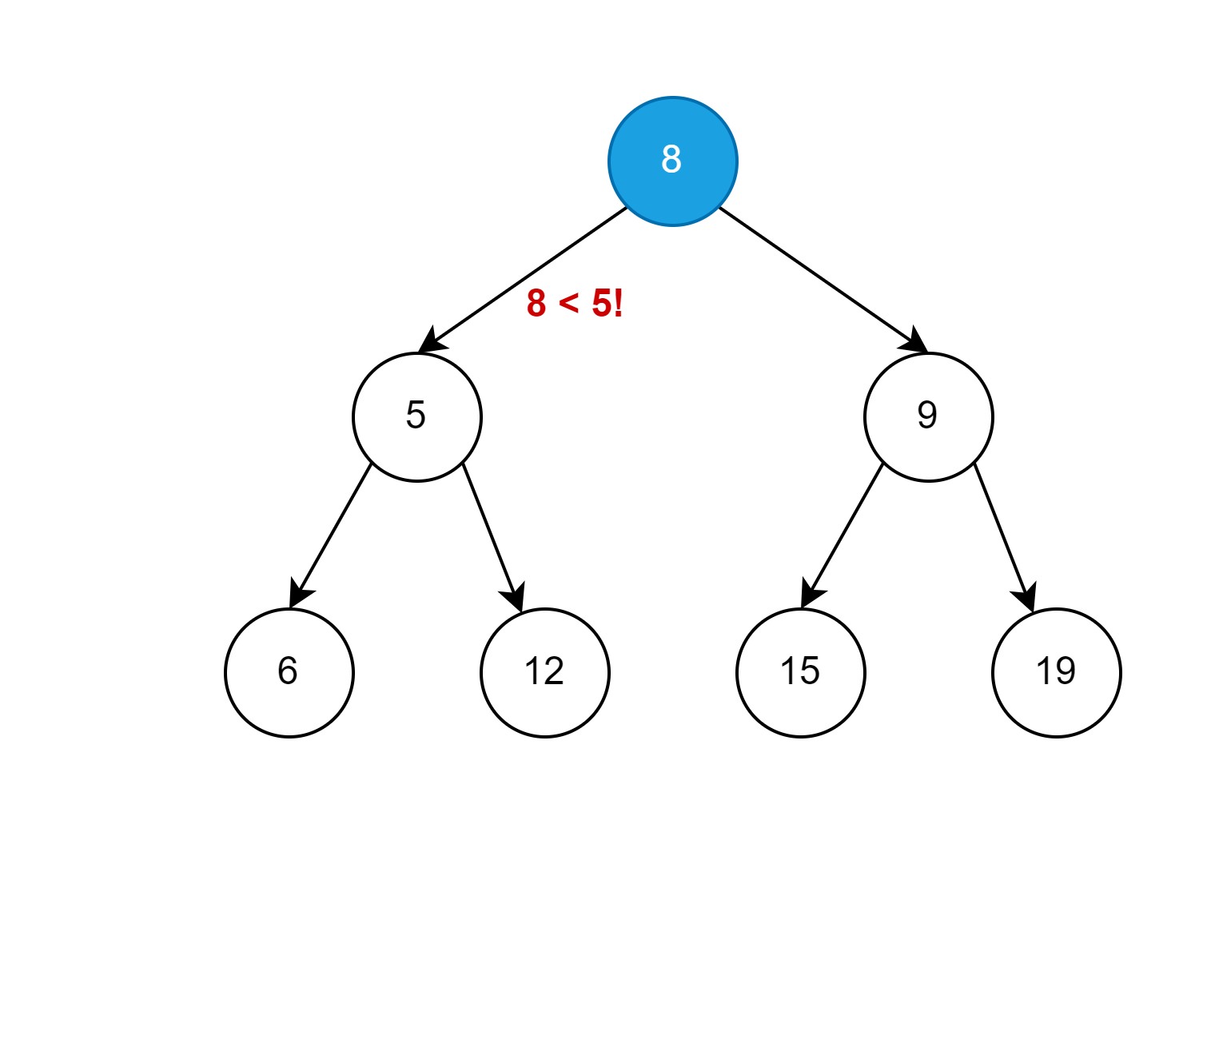
Binary Heap – How to Keep Integrity
Easy to delete and balance – just bubble added node.

Slide 10
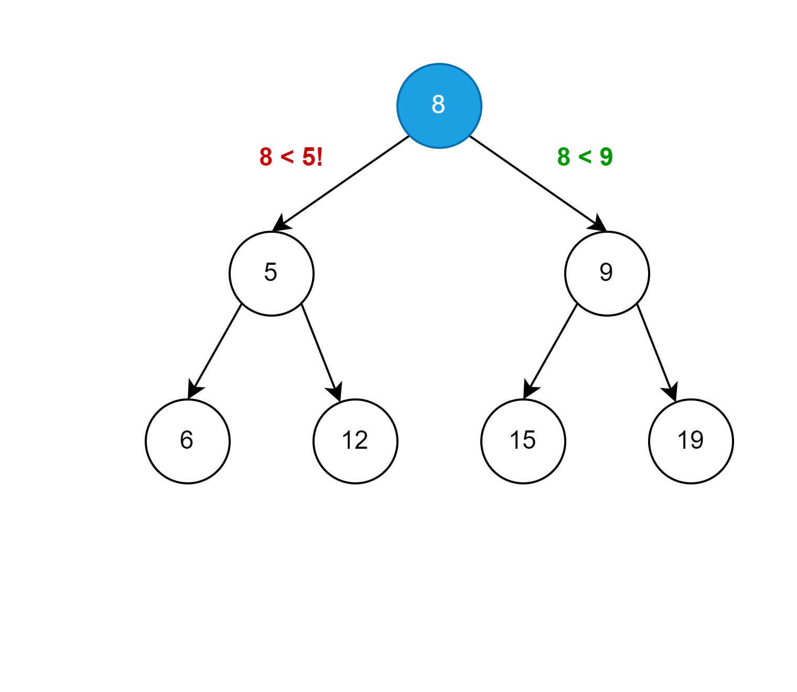
Binary Heap – How to Keep Integrity
Easy to delete and balance – just bubble added node.

Slide 11
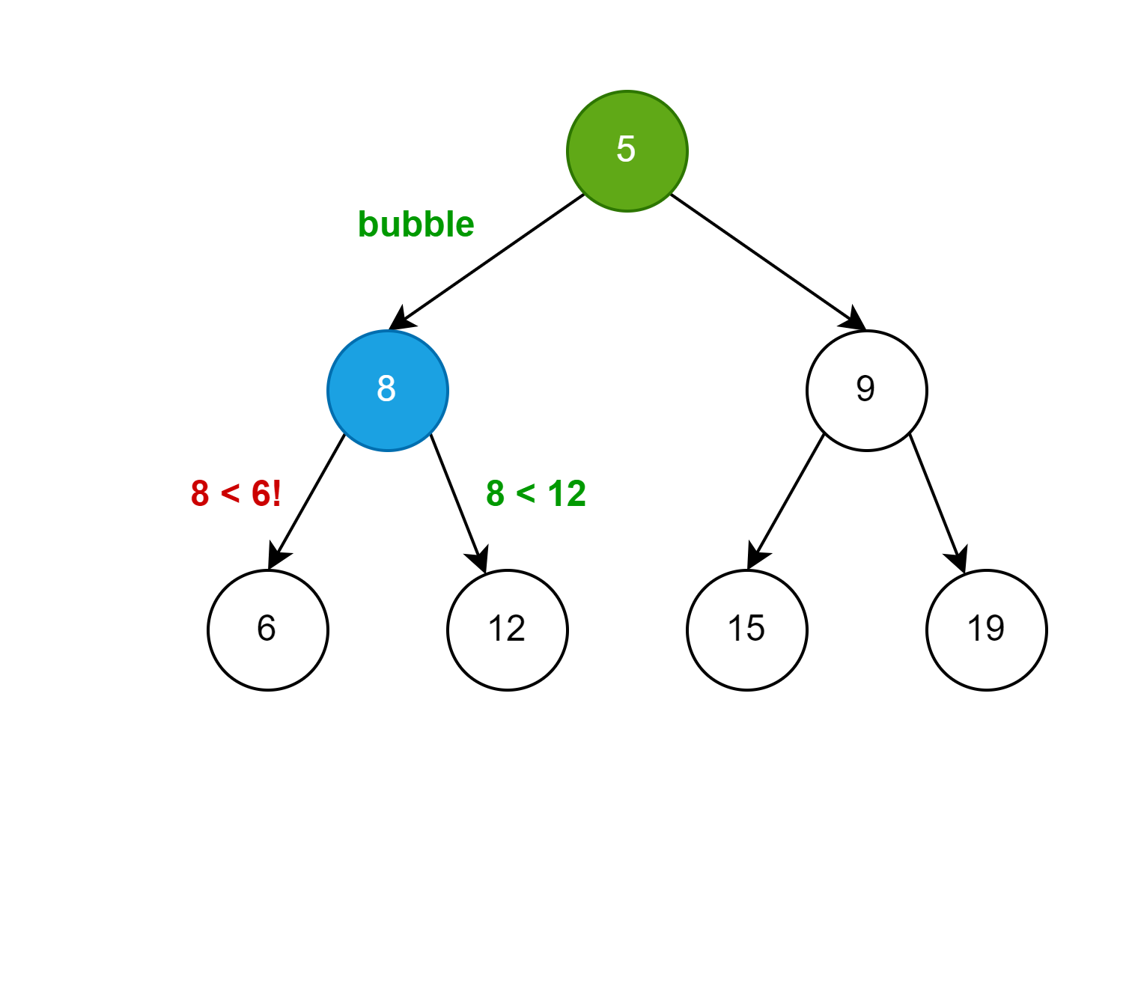
Binary Heap – How to Keep Integrity
Easy to delete and balance – just bubble added node.

Slide 12
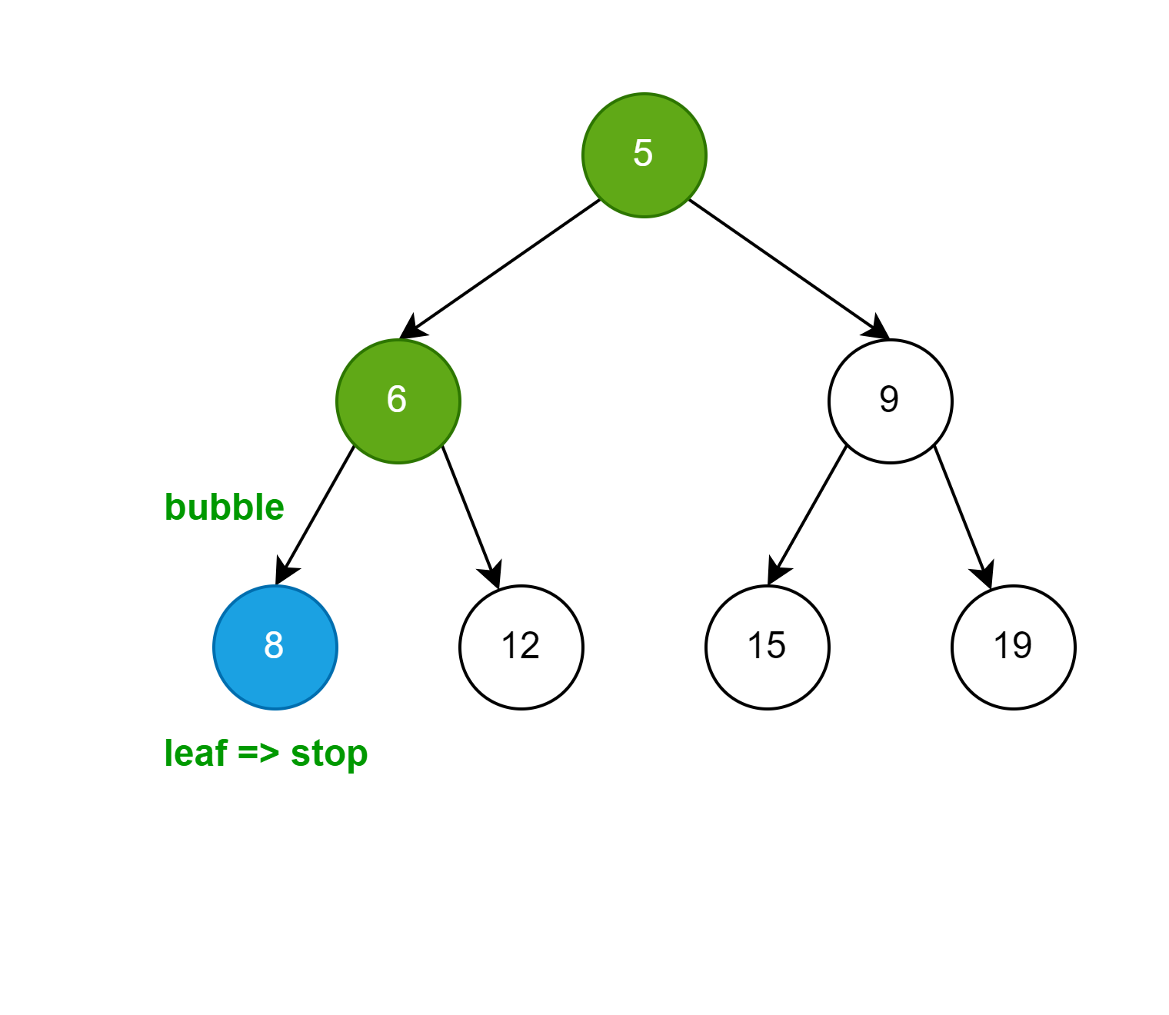
Binary Heap – How to Keep Integrity
Easy to delete and balance – just bubble added node.

Slide 13

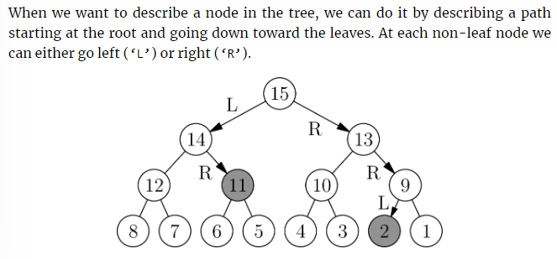
Practice – Priority Queue I
Kattis – Numbers on a Tree
Link to the Task

Slide 14
Practice – Priority Queue I
Kattis – Numbers on a Tree
Link to the Task
How to represent tree in array?
How to reach left and right children?

Slide 15
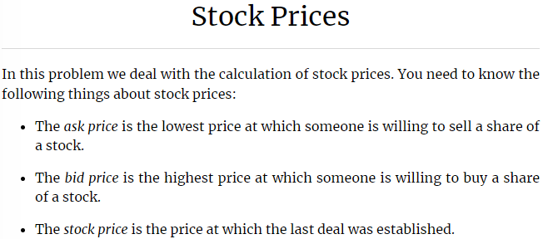
Practice – Priority Queue II
Kattis – Stock Prices
Link to the Task

Slide 16
Practice – Priority Queue II
Kattis – Stock Prices
Link to the Task
How to utilize a binary heap?
How to utilize a red-black tree?
Discuss pros and cons.

